Slide 1

Introduction to
Jessica “STING” Peterson
Open Matlab while we get started!

Slide 2
Objectives
Get Matlab working for you here at TPS
Matlab newbies: Equip you enough to be dangerous
Matlab wizards: Show you how to use TPS tools for data processing
Demonstrate data analysis tools previously developed
It is impossible to make you a MATLAB expert in 1.5 hours. The intent of this class is to kick start your learning (or re-learning) of this powerful tool!
Notes:
We’re not going to make you a power user or level 9 Matlab Wizard in the next hour and a half. Enough to arm you to work on your own, and to play around with the existing functions that are helpful here at TPS.

Slide 3
What we’re covering
Initial Setup and Familiarity
Basic Functionality
Tools for using TPS Instrumentation Data
Example Project

Slide 4
Setup Matlab
Copy folders from “R drive” to → My Documents\MATLAB
R:\21-B\1.0 - Academics\TF 6510 - Intro to MATLAB\code
Set and save the file path
Option 1: “Set Path” in HOME tab → “Add with subfolders”→ “Save”
Option 2: Right click folder → “Add to path”→”Selected folder and subfolders”
Type “savepath” into console
Open “instructor_example.m” and “Run”
Familiarize with code, comments, and output figure

Slide 5
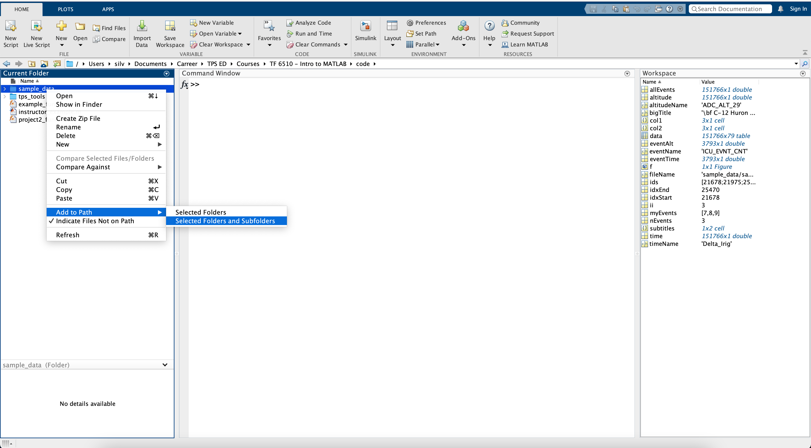
Adding folders to path

Slide 6
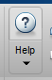
Getting Help!
Help Button
doc “function_name”
help “function_name”
Google “MATLAB _______”
Matlab Central
Caution!
You may find answers on the internet that apply to a different version of Matlab!
Pay attention to Matlab version: 2015B vs. 2020A
Notes:
Show the various ways to get help on plots.
As of 10 July 2018, searching “Matlab Plots” in Google yields the page shown as the first item.
WRT the Caution – if you search for “Matlab plot multiple y axes,” in the R2015b docsearch you’ll find plotyy as the 8th item on the list, whereas online (R2018) will point you to use yyaxis

Slide 7
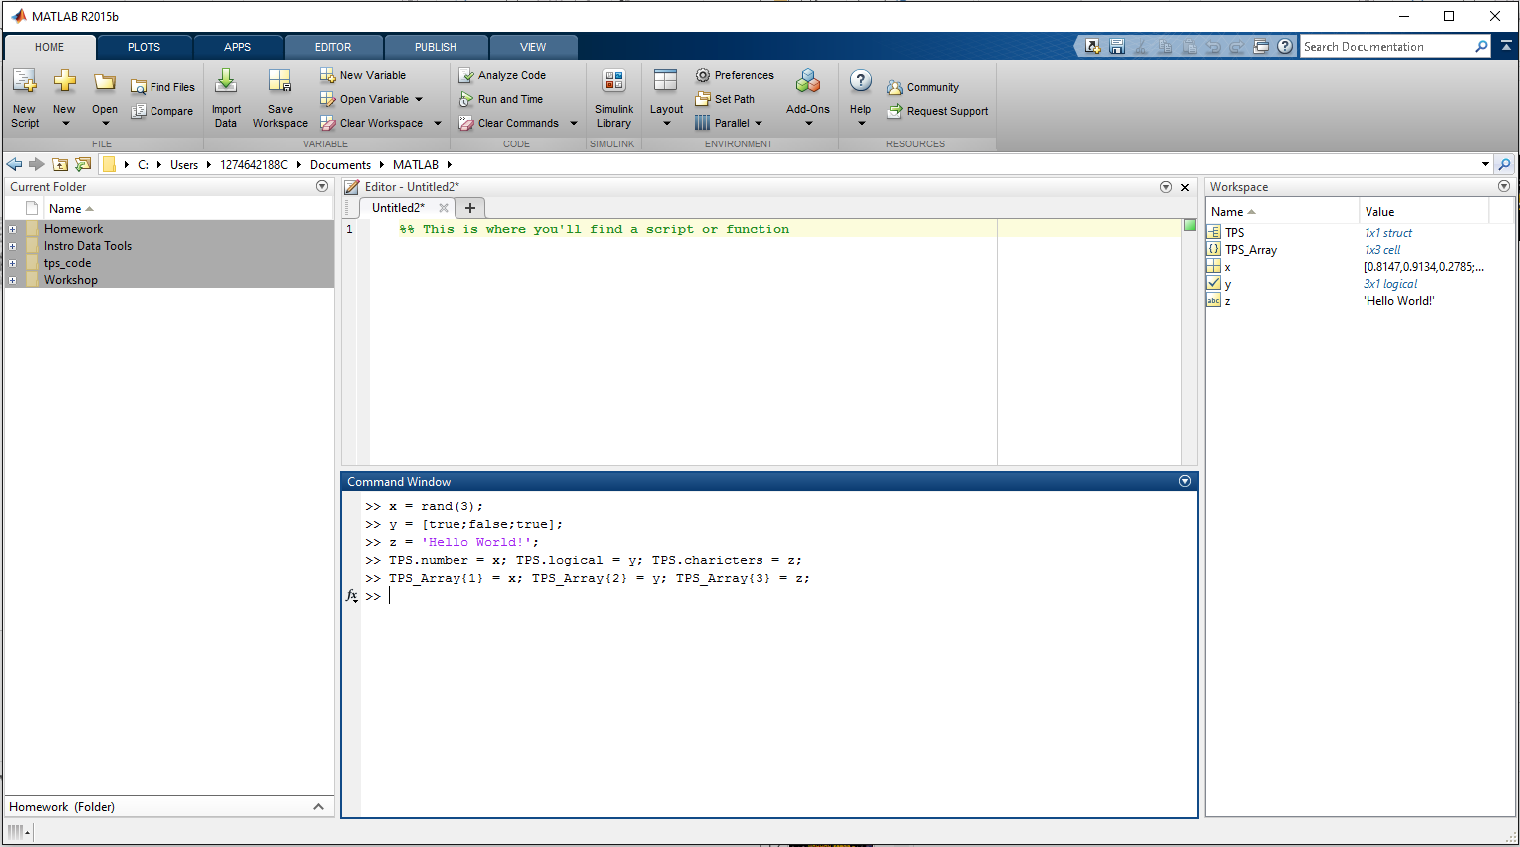
Basic Layout Fam
Get-well
Moving Windows
Docking/Undocking
“Home” tab

Slide 8
What we’re covering
Initial Setup and Familiarity
Basic Functionality
Tools for using TPS Instrumentation Data
Plotting
Example Project

Slide 9
Why Matlab?
MATrix LABoratory (MATLAB)
Fast Matrix Math
Excel is slow with large quantities of data
MATLAB easily handles large amounts of raw data
Powerful Toolboxes for many disciplines
Statistics, signal processing, control systems, etc…
Makes programming accessible to the novice user
Interpolated language – no compiling

Slide 10
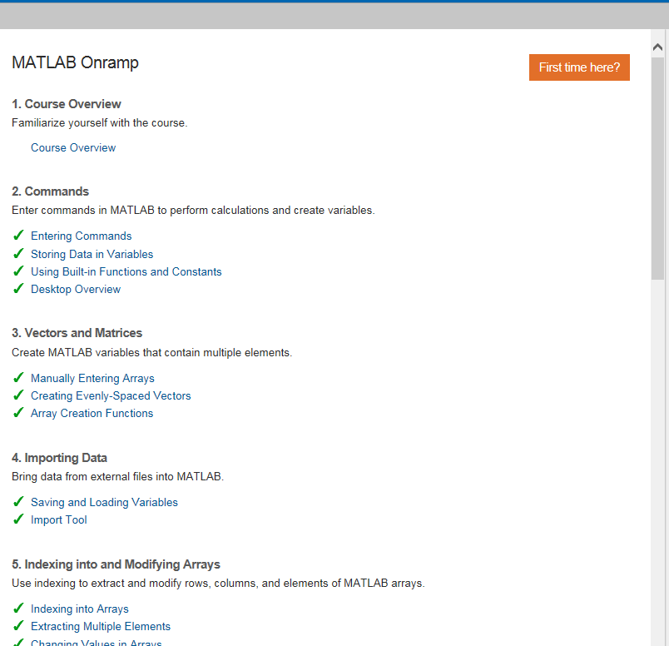
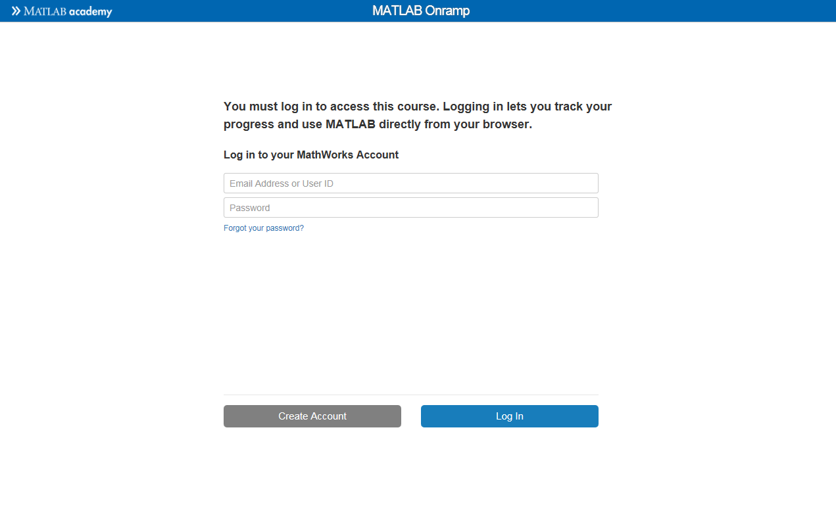
You did finish the MATLAB Academy Module, right?
https://matlabacademy.mathworks.com/
Create an account to access the course.

Slide 11
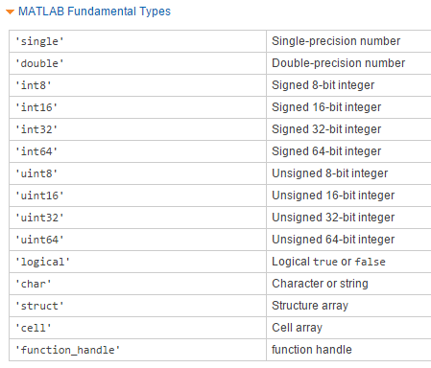
Basics Refresher
Variable assignment
REMINDER - MATLAB does not accept spaces in variable or file names
Use “_” instead
Data Types
numeric
logical
Character Arrays
Structures
Cell Arrays
Demo math functions
sin(pi/2)
sqrt(100)
Notes:
Functionality discussion – cover arrays & array indexing

Slide 12
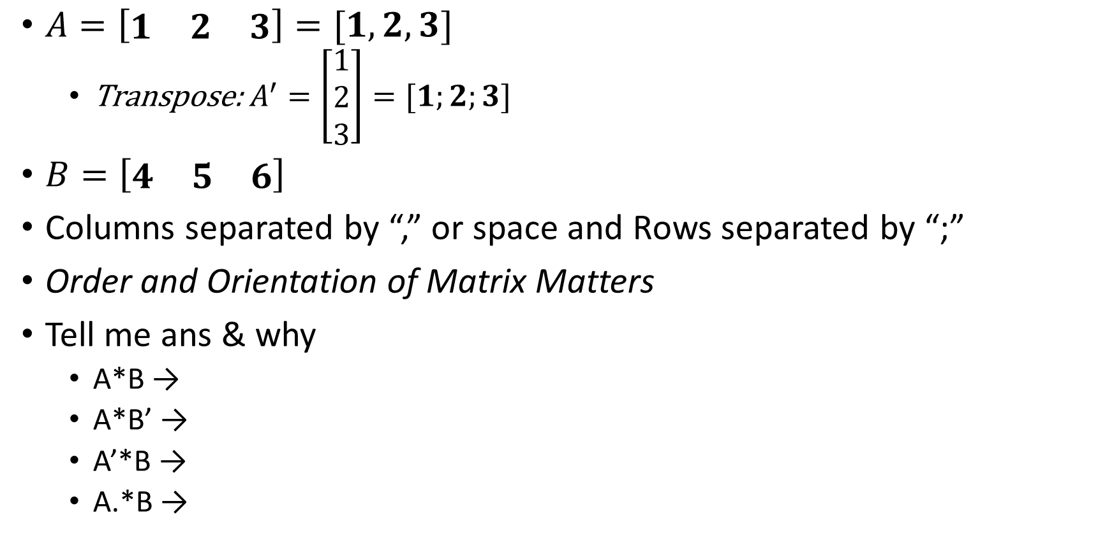
Common Errors – Matrix Math
$A=\left[\begin{matrix}1 & 2 & 3\end{matrix}\right]=[1,2,3]$
Transpose:$A^{′}=\left[\begin{matrix}1 \\ 2 \\ 3\end{matrix}\right]=[1;2;3]$
$B=\left[\begin{matrix}4 & 5 & 6\end{matrix}\right]$
Columns separated by “,” or space and Rows separated by “;”
Order and Orientation of Matrix Matters
Tell me ans & why
A*B →
A*B’ →
A’*B →
A.*B →
Notes:
Error (inner dimensions must agree)
32
[4 5 6; 8 10 12; 12 15 18]
[4 10 18]

Slide 13
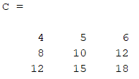
More Matrix Fun
Accessing Values in Arrays
C = [4 5 6; 8 10 12; 12 15 18]
C(2,1) accesses value in row 2, column 1
C(2,:) provides all values in row 2
C(:,2) provides all values in column 2
How do I get Rows 2 and 3 in Column 1?
MyText = 'Hello World‘;
How do I access just the last word?

Slide 14
Scripts (aka “m” files)
Nothing more than a bunch of commands stored in a file
MATLAB compiles as it executes
Cleanup
clear all - clears all variables in workspace
close all - closes all figure windows
clc - clears the command window screen
Good to do before new scripts are run
Create new .m file
Use % at the beginning to make comment lines
Save script as Example_19B.m
(Remember, no spaces allowed)

Slide 15
What we’re covering
Initial Setup and Familiarity
Basic Functionality
Tools for using TPS Instrumentation Data
Plotting
Example Project

Slide 16
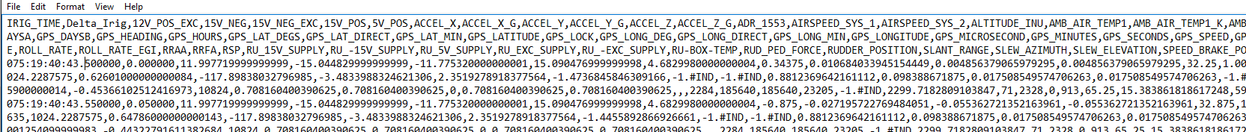
Data
TPS/TS will produce time stamped data in .csv format
Drop data off with James &/or Jordan

Slide 17
Importing Data
Several options for loading data
More function call options than shown
csvread(filename) Only Numerical Values
(Won’t work w/ TPS DAS data because of the header!)
xlsread(filename) Only Excel files. (Works w/ *.csv but takes a long time, if it works)
readtable(filename) Any Data Type
tpsread(filename) Only Numerical Values
Manually in Matlab – double click file
Evil’s TPS_data_norm a real-time view and parser of data
Decide what works best for you
Some may be quicker for automation

Slide 18
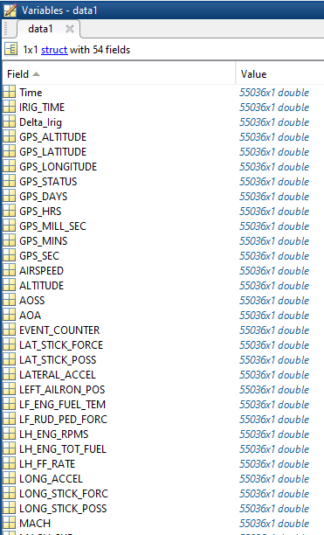
Opening Data
File_name = 'C:\Users\[ID#]\Documents\MATLAB\tps_code\Examples\F-16 Chap 10.csv';
Use TPS read
data1 = tpsread(File_name);
data1 is a Structure
Access the data with “data1.PARAMETER”
I.e. “plot(data1.IRIG_TIME, data1.MACH)”
Automatically saved as a “*.mat”
Only have to “read” one time
…

Slide 19
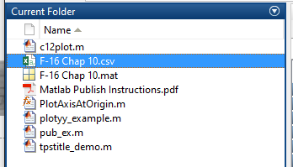
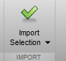
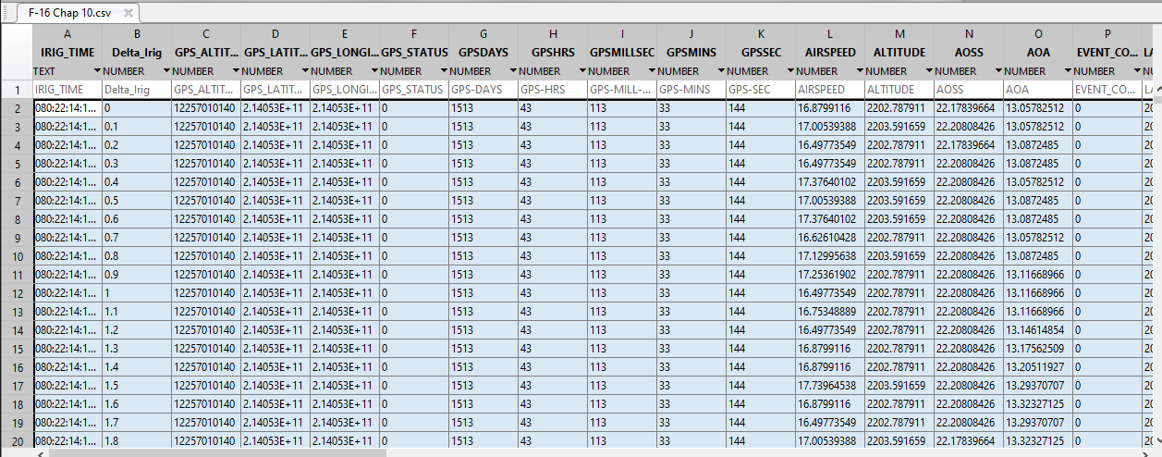
Manual Input
Double Click File (from the “current folder”)
Highlight the data you want
“Import Selection”
Now local variables in workspace
Save for reuse as a *.mat file
Right Click -> Save As

Slide 20
Evil Bill’s TPS Data Norm
Basic Steps
Open TPS_data_norm
Select the data CSV file
Select the output location
If you have a lot of events, select the “Create Separate Event Structures”
Select “Open Quick Data Review Utility” to manipulate data now, if not, you can use TPS_data_utility later
Click Go
Select parameters of interest
Once done, it moves to TPS_data_utility
Open the file you just created
Manipulate data with the utility GUI

Slide 21
Evil Bill’s Data Utility
Data Utility
EC_### are “Subsets” by event numbers
Select a new range of data
Click on the plot for the beginning of your test point and select the left side “Set”
Click on the plot for the end of your test point and select the right side “Set”
Type in a name in “New Subset Name” and click “Create New Subset”
New subset shows up under the dropdown menu
Save subset as Matlab file
Click on “Create WS Vectors”
Select the data of interest
Go to the Workspace window and right click to save to a .mat file
See relationship between two parameters
Select IV for independent variable
Select DV for dependent variable
Click “Plot DV = fn(IV)”

Slide 22
Other Tools
Lots of pre-made scripts available
ucon.m (unit conversion)
Pitot_Statics folder (everything pitot statics)
Statistics folder

Slide 23
What we’re covering
Initial Setup and Familiarity
Basic Functionality
Tools for using TPS Instrumentation Data
Plotting
Example Project

Slide 24
Basic Plotting
2D Plotting Examples
plot(x) Default line plot
plot(x,'.') Plots data points with markers ('+', 'x', 'o' etc.)
Combine w/ other modifiers for color (‘r’, ‘g’, ‘b’) & line type (‘:’, ‘-.’, ‘--’)
plot(time,x,'.') Adds x-axis values to display
hold on Allows additional traces to current plot
plot(time(10:50),x(10:50),'r') You can plot subsets (ensure same # of points)
figure(3) Create additional figure
plot(time,x,'-.ok','LineWidth',3,'MarkerSize',10,'MarkerFaceColor',[1,0,0])
You can change the line type, line size, marker size, etc.
Notes:
time = Delta_Irig;
x = ALTITUDE;

Slide 25
Multiple Plots and Saving Figures
Create a new figure
figure; or figure(2)
Saving figures
saveas(gcf,'Sample Figure.fig')
Can re-open in MATLAB and edit
saveas(gcf,'Sample Figure.png')
Put it into a report!

Slide 26
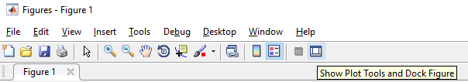
Making prettier plots
Label your axes (more on this in later classes)
xlabel('Elapsed Time (seconds)','FontSize',14,'FontWeight','bold')
ylabel('Altitude (feet)','FontSize',14,'FontWeight','bold')
title('Simple Title','FontSize',18,'FontWeight','bold')
Put data in your titles:
mn_data = mean(x);
std_data = std(x);
title(['My First Plot with \mu = ' num2str(mn_data) ' and \sigma = ' num2str(std_data)]);
Open the editor for more power
Use TPS Title for Flight Test Figs
bigtitle = 'My First Plot';
coltext = {{1st Column Array},{2nd Column Array}}
fonts = [14 11]; ratios = [0.1 0.7];
tpstitle(bigtitle,coltext,fonts,ratios);
Notes:
TPS Title Example
bigtitle = 'My First Fancy Title';
Array1{1,1} = 'Aircraft';Array1{2,1} = 'Date'; Array1{3,1} = ' '; % empty space to allow column lengths to match
Array2{1,1} = 'Fuel Load: xx klbs';Array2{2,1} = 'Maneuver';Array2{3,1} = 'Standard Day';
coltext = {Array1, Array2};
fonts = [14 11]; ratios = [0.1 0.7];
tpstitle(bigtitle,coltext,fonts,ratios);

Slide 27
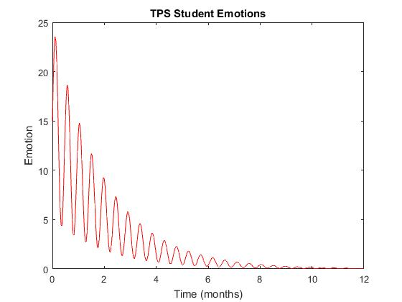
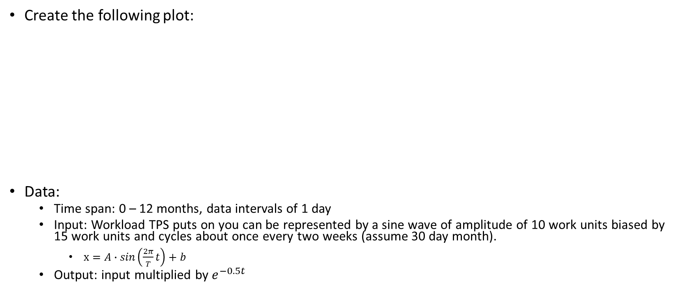
Practice / Knowledge Check
Create the following plot:
Data:
Time span: 0 – 12 months, data intervals of 1 day
Input: Workload TPS puts on you can be represented by a sine wave of amplitude of 10 work units biased by 15 work units and cycles about once every two weeks (assume 30 day month).
$x=A∙sin\left(\frac{2π}{T}t\right)+b$
Output: input multiplied by $e^{−0.5t}$
Notes:
See SHACK for the script showing one way to do this

Slide 28
What we’re covering
Initial Setup and Familiarity
Basic Functionality
Tools for using TPS Instrumentation Data
Plotting
Example Project

Slide 29
Example Project
C:\Users\1274642188C\Documents\MATLAB\Instro Data Tools
Use the data file Example_C12.csv
Pitch Doublet Parameters
Delta_Irig (time)
POS_AOA (AoA)
POS_YOKE_LON (Yoke Position)
ADC_ALT_29 (Pressure Altitude)
ADC_IAS (Indicated Airspeed)
Data
Event #8
Save as example_Phugoid.mat

Slide 30
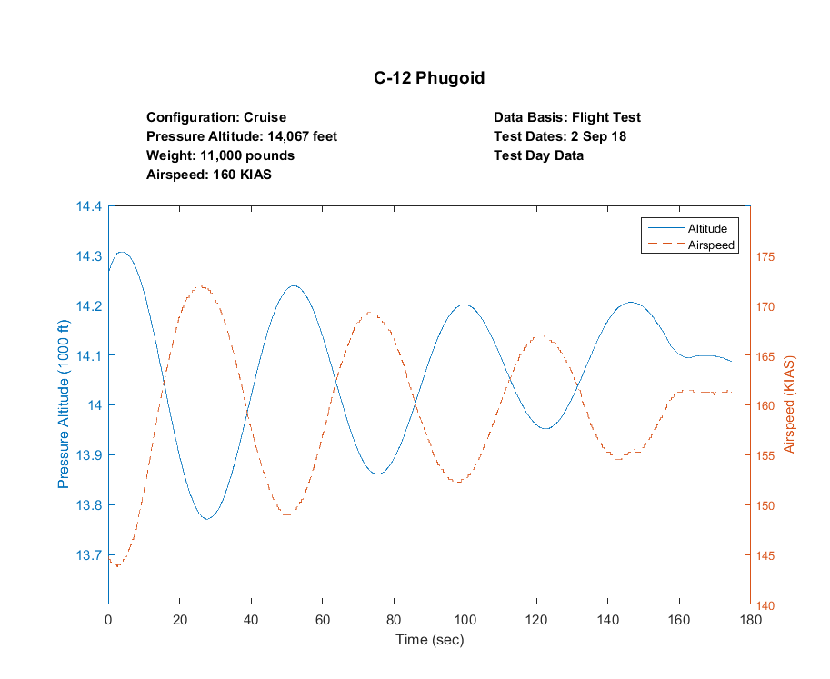
Exercise Plot
We are going to plot the Phugoid response:

Slide 31
Your Turn = “Homework”
.. \Documents\MATLAB\Homework
Assignment: MATLABHomework_20170725.pdf
Data File: “Lat_Dir_Data.csv”
Method:
Your choice

Slide 32
Additional Resources
.. \ Documents\MATLAB\tps_code\Reference
Good resources (though most a little dated)
..\Documents\MATLAB\Homework
Good exercises to get you more familiar with the functionality of MATLAB and the DAS data – NOT GRADED
We don’t have the time to get to this in class, though we can start (time dependent). It is an optional exercise. I will gladly assist or work these exercises with you off line if desired.
..\Documents\MATLAB\Workshop
We’ll work this during the remainder of class
Great opportunity to look at scripts of “fair” complexity and get you spun up looking at data
MATLAB Central (“Community” button)
http://www.mathworks.com/matlabcentral/fileexchange/

Slide 33
Backup

Slide 34
Structures & Cells
Structures
Helpful for organizing data
Across numerous flights
Or test points within a flight
Define
x = data.x;
time = data.Delta_Irig;
aoa = data.AOA;
Cell Arrays {}
Can be used to store strings, matrices, etc.
s = ‘Hello’;
t = ‘There!’;
S = {s,t,C} Variable names are case sensitive
Call back using {}… p = S{2} -> p = There!

